Slide 1
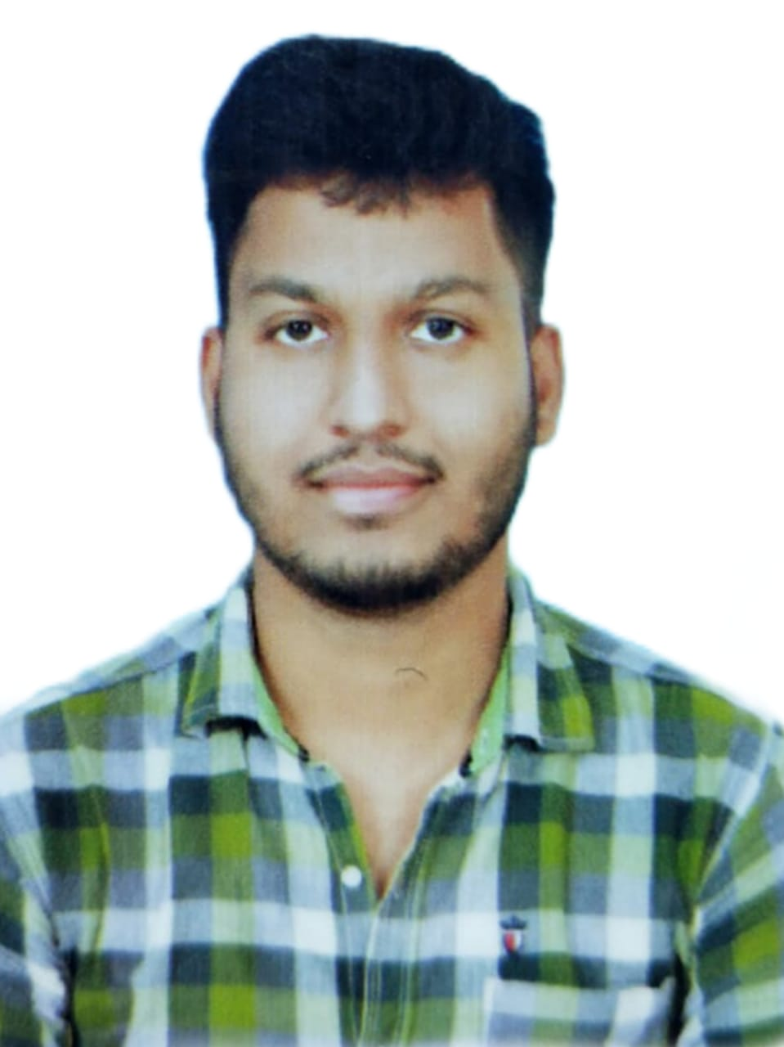

Gaurav Kumar Gupta
Analyst/Software Engineer
Bachelor of Technology,
Civil Engineering : 2018-22
I Transform L&D Left shift batch
Skills
MUMBAI
JAVA | Basics, OOPS, Exception Handling ,Arrays ,Collection
Spring Framework | ADO.NET,ASP.NET with MVC5 and WEB API, Entity Framework
C | Basics, OOPS, Exception Handling ,Arrays
Database | SQL , Mongo dB
Tools | GIT,POSTMAN, IntelliJ IDEA Eclipse Visual Studio Code
UI Technology | HTML ,CSS, JavaScript & Angular
Add On Skills | Communication Skills, Team Management , Quick learner
GAURAV.KUMAR-GUPTA@CAPGEMINI.COM
+918809458619
A4
EShoppingZone
EShoppingZone is an eCommerce website, E-commerce is the activity of buying or selling products on online services or over the Internet. There are two roles one is the merchant where he sells the products and the other is the customers. Here customers can create an account and log in to their active account. Users can browse various types of products. Products on this site will be displayed category-wise . In this, I have used Spring for the backend part and Angular for the front-end part.
Technologies used:
HTML,CSS, JAVASCRIPT
ANGULAR
SPRING BOOT
EUERKA SERVER
MONGODB
Full Stack Developer
Practical understanding of JAVA and SQL concepts using Eclipse and SQL Server.
Understanding of RDBMS concepts using SQL Server.
Hands on experience in developing applications using Angular CLI, Spring core, Mongo DB.
Understanding of HTML5 , CSS and JavaScript.

